Slide 1
DATABASE AND ANALYTICS PROGRAMMING
PRESENTED BY
ADITYA MUKHERJEE- x20161131
PIYUSH DHANDE-x20115725
ABHIJIT SAHASRABUDDHE-x20180799

Slide 2
dATASETS
Crimes related to shooting in New York-Data fetched using API
House Sale in New York-Data fetched using API
Accidents in New York-Semi structured nested JSON file

Slide 3
ETL-Extract, Transform & load
Automation with Dagster
Inserting semi structured data in MongoDB
Importing data from MongoDB in Python data frame
Data Processing
Loading final tables in Python for visualization
Merging tables using informatica cloud
Loading data in MySQL tables

Slide 4




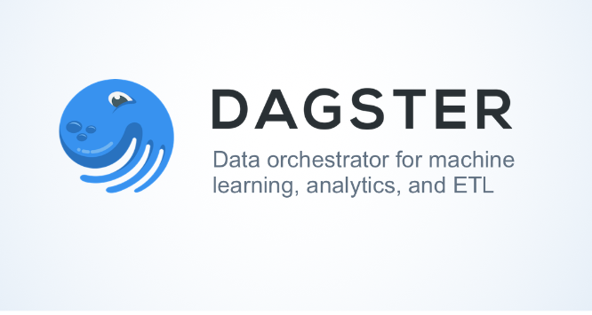

Tools used

Slide 5
WHY MONGODB, MySQL, Python and Informatica Cloud?
NOSQL database (MongoDB) is used to handle semi structured data
To handle unstructured/semi structured data
MySQL(AWS RDS)
AWS RDS for dynamic access required for collaboration
Python
wide range of libraries available for data processing and visualization
Informatica Cloud
To automate final table creation using 3 distinct tables as source
Dagster
To automate data processing.

Slide 6
Python packages used
Package | Purpose
Pymongo | Used to connect to MongoDB
pymysql | To connect to MySQL instance on AWS RDS
sqlalchemy | To run SQL commands from python
Matplotlib | For Data visualization
Folium | Geospatial Analysis
Plotly | For Data visualization
seaborn | For Data visualization
Geopandas | Geospatial Analysis
Pandas | Data frame creation data analysis

Slide 7
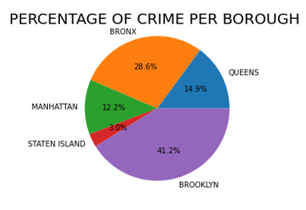
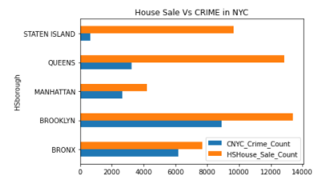
NYC-Crime Data Analysis

Slide 8
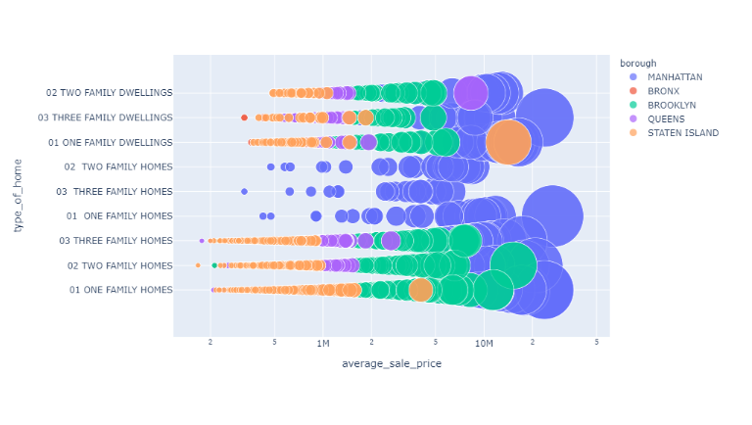
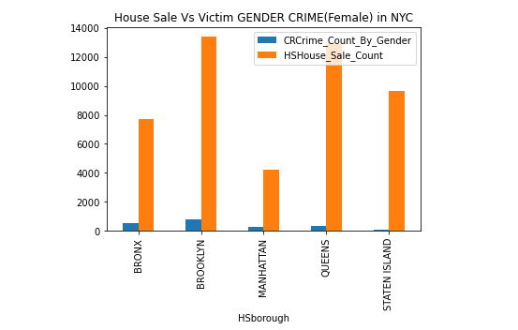
NYC-House Sale Data analysis

Slide 9
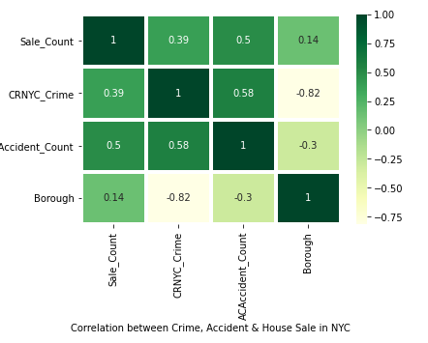
Correlation Matrix
-1 suggests perfectly negative linear correlation
0 indicates no linear correlation
+1 suggests perfect positive linear correlation

Slide 10
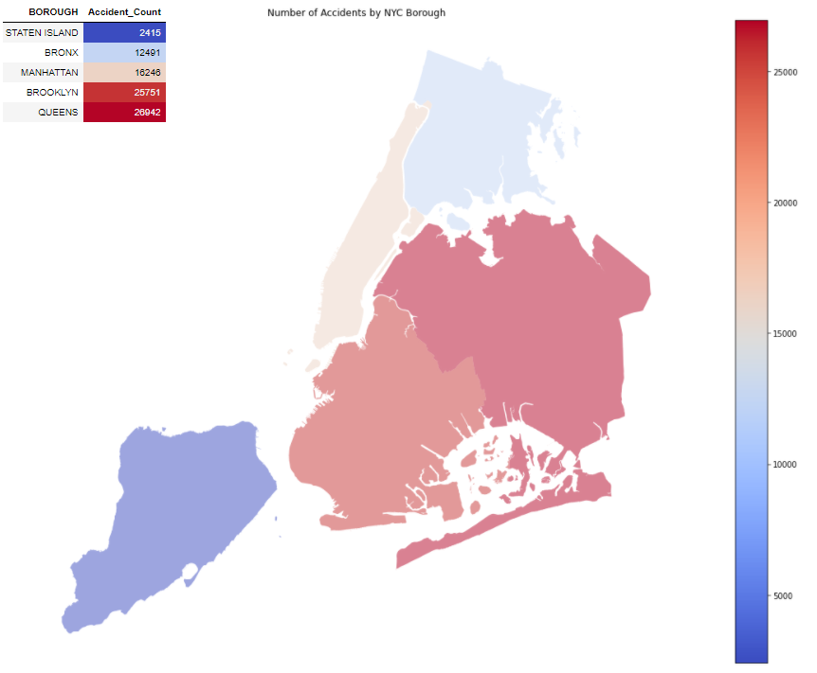
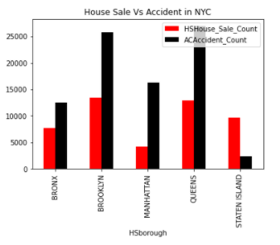
NYC-Accident data analysis

Slide 11
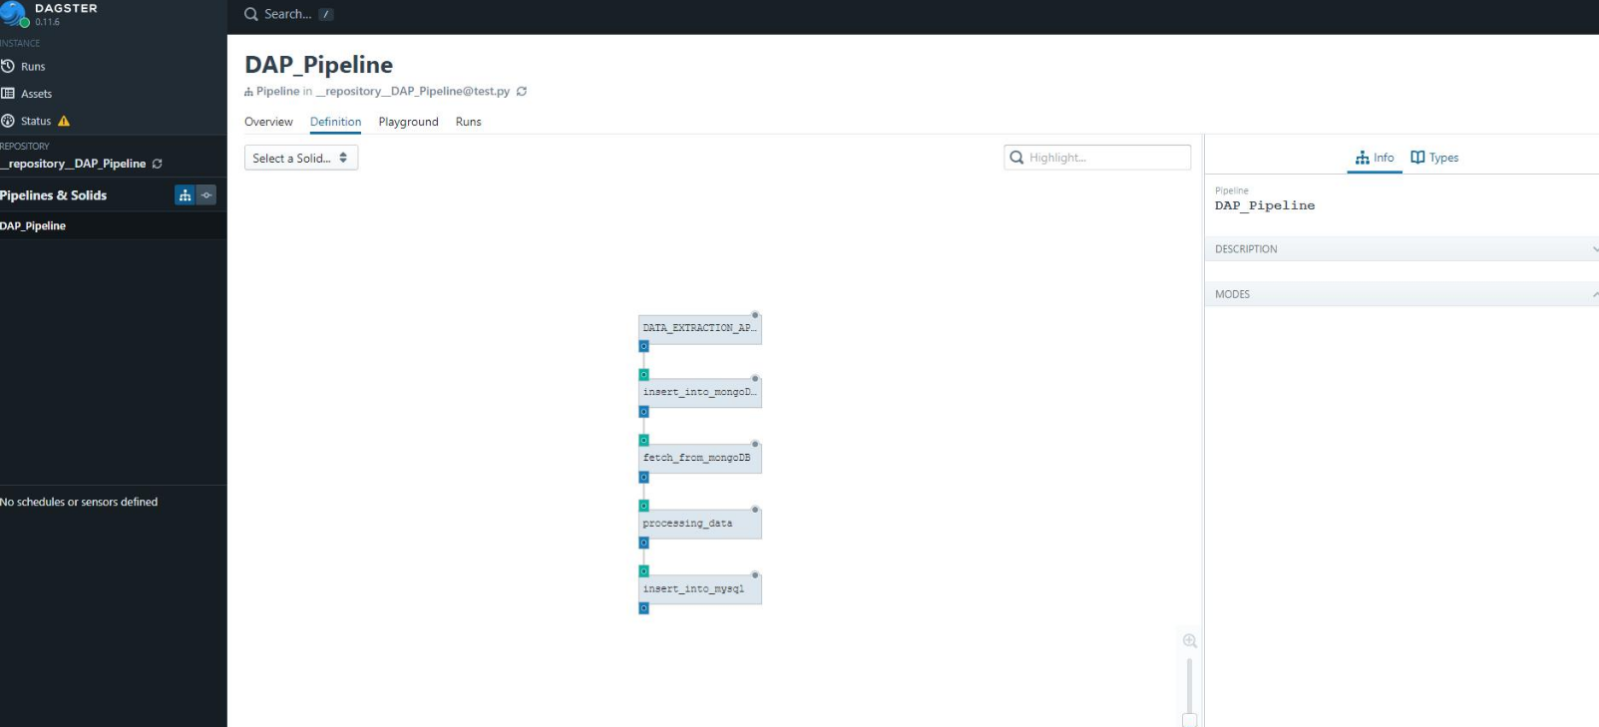
Automation-dagster

Slide 12
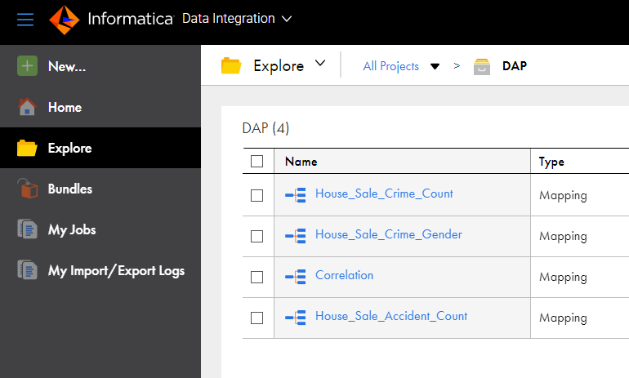
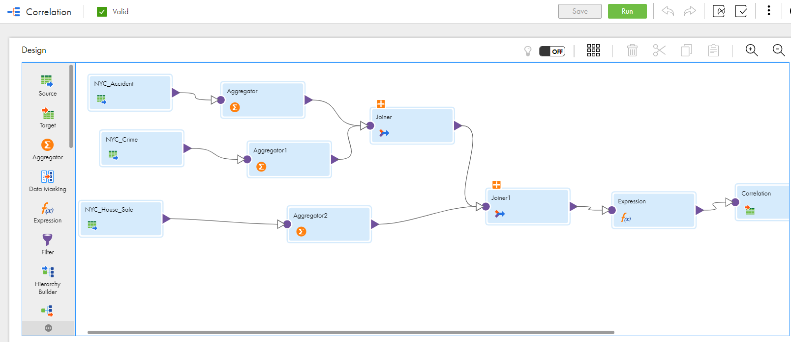
Automation-Informatica cloud

Slide 13
Thank you

